Slide 1
Mobile Applications
Group 48 - Campus Event App

Slide 2
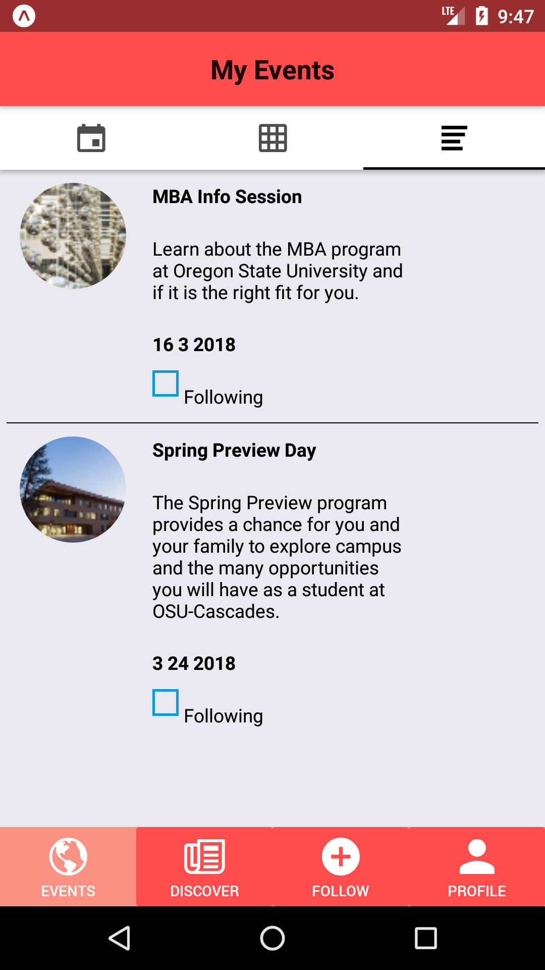
Current progress of project
Four screens: Events, Discover, Following and Profile are all added to index.js.
Events screen contains three tabs: calendar view, box view and list view.
Use getTheme and material to customize themes for the footbar.
Finish implementing backend of the mobile application. Successfully linking database to the application.

Slide 3
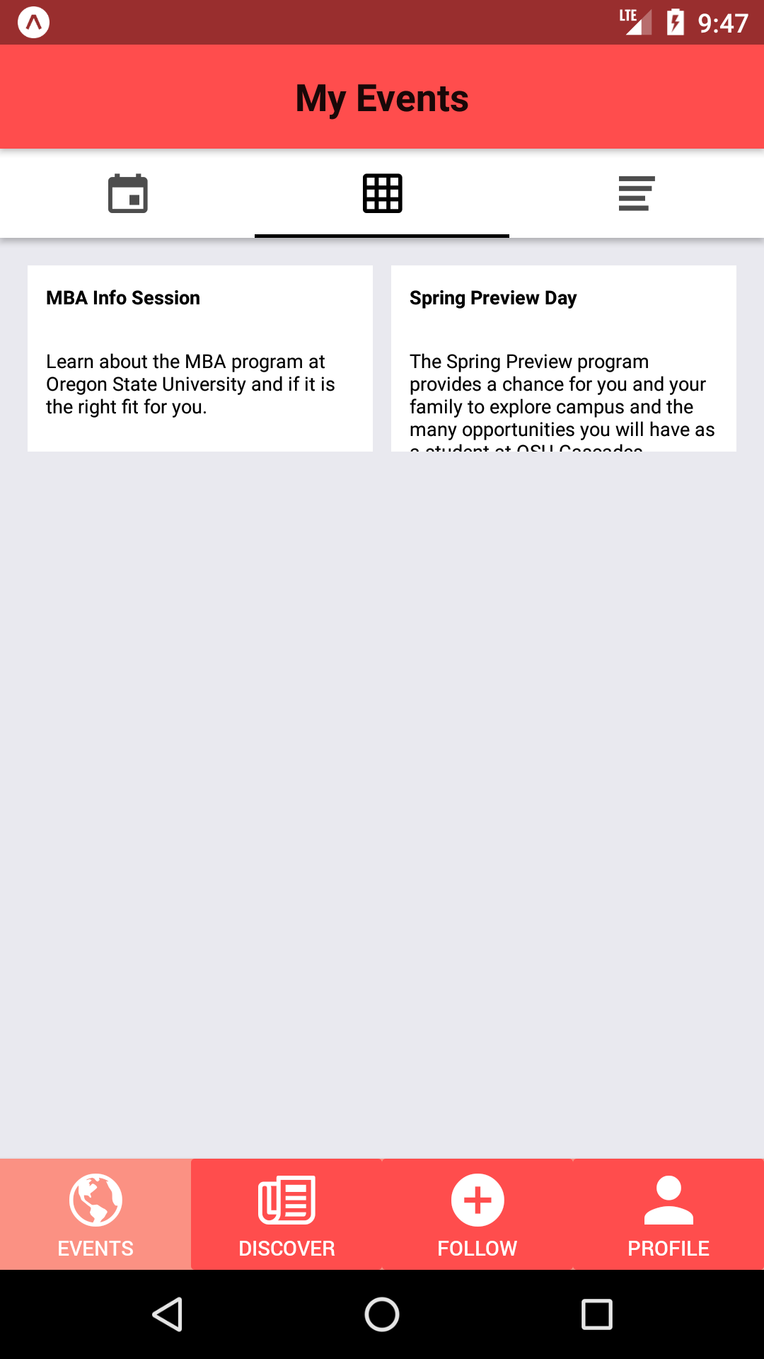
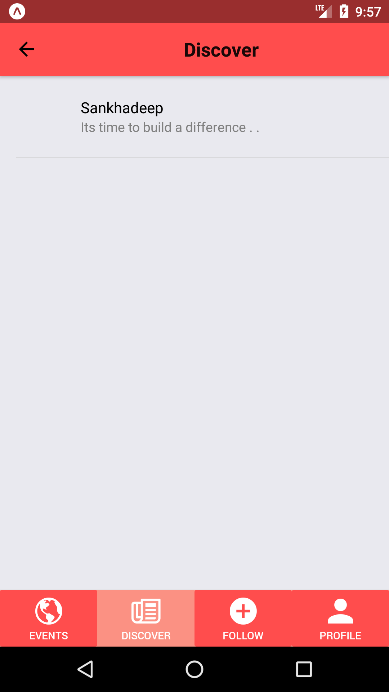
Current progress of project(continue)
Grid View page is also successfully linked to database
No content in event_category screen inside Discover screen due to we still don’t know where to get the source data of events.

Slide 4
The works that need to be done
Secure Login using oAuth 2
After all functionalities are implemented, we need to make sure there’s no bug will affect the functionality of the application.

Slide 5
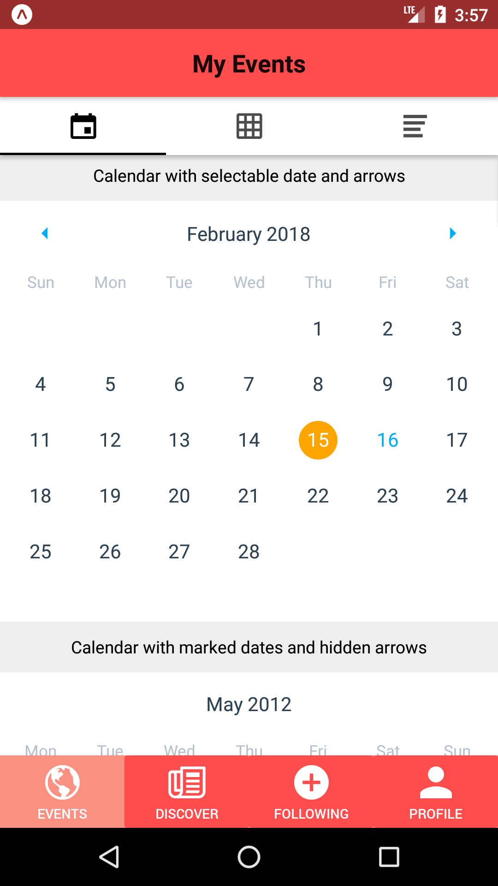
Problems encountered
No experiences for using React Native
Wired problems encountered during development
No experiences on setting up local database
Have no idea about how to convert data from database to JSON strings

Slide 6
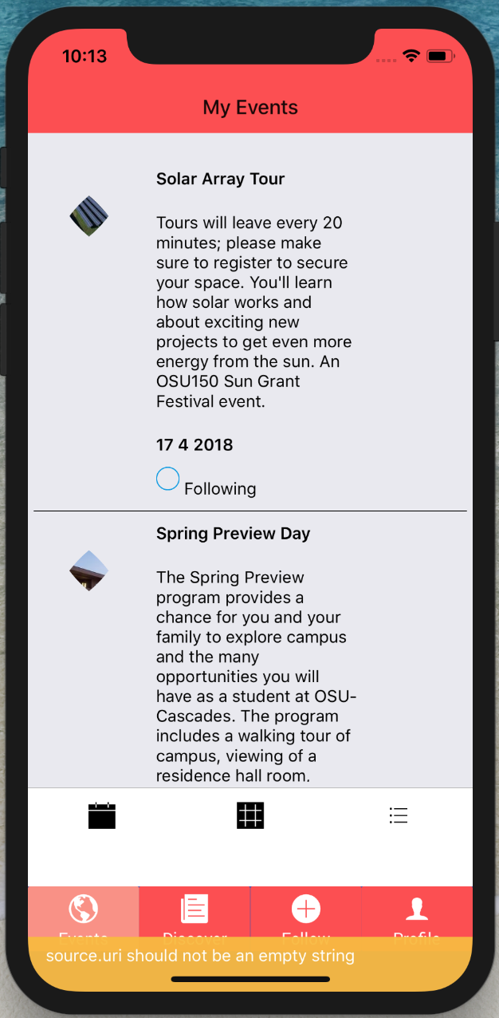
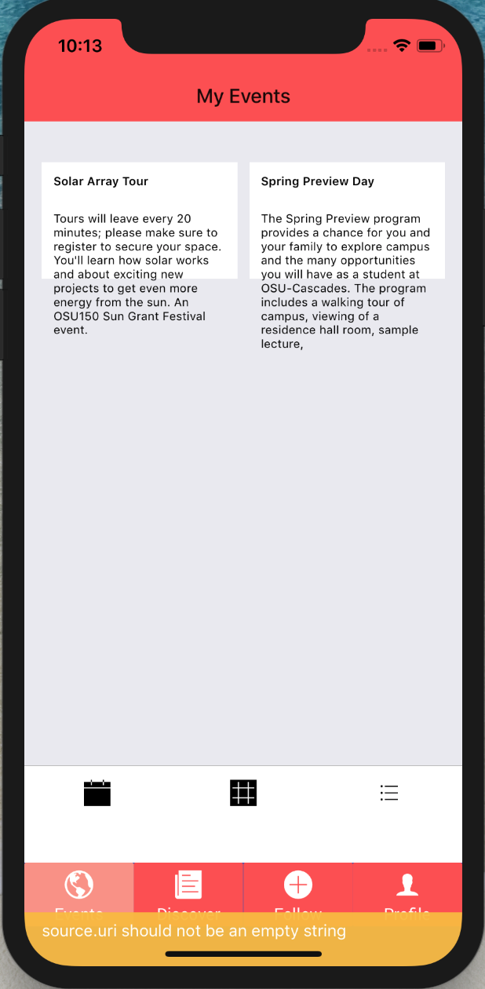
Current project on IOS
Four screens same as Android platform
Using dummy data for testing

Slide 7
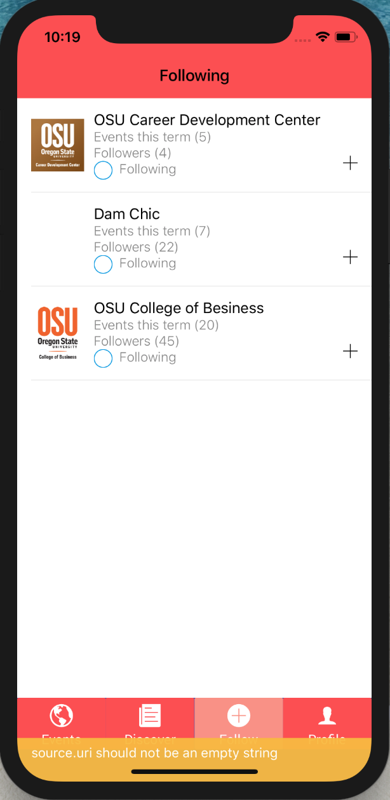
Current progress of project
The following page connecting to database
The “Add” button for group detail
The “Following” button to achieve following function

Slide 8
Problem and left
Joining different tables in database
Set up the web browser development done
Fixing bugs i.e. the IOS platform bottom

Slide 9
Web browser development
The web browser development is one of our goals
The development is now preparing for temporary
By using the HTML, CSS, JavaScript and PHP
Database should be connected to app by using SQL
The web browser development is not a requirement.

Slide 10
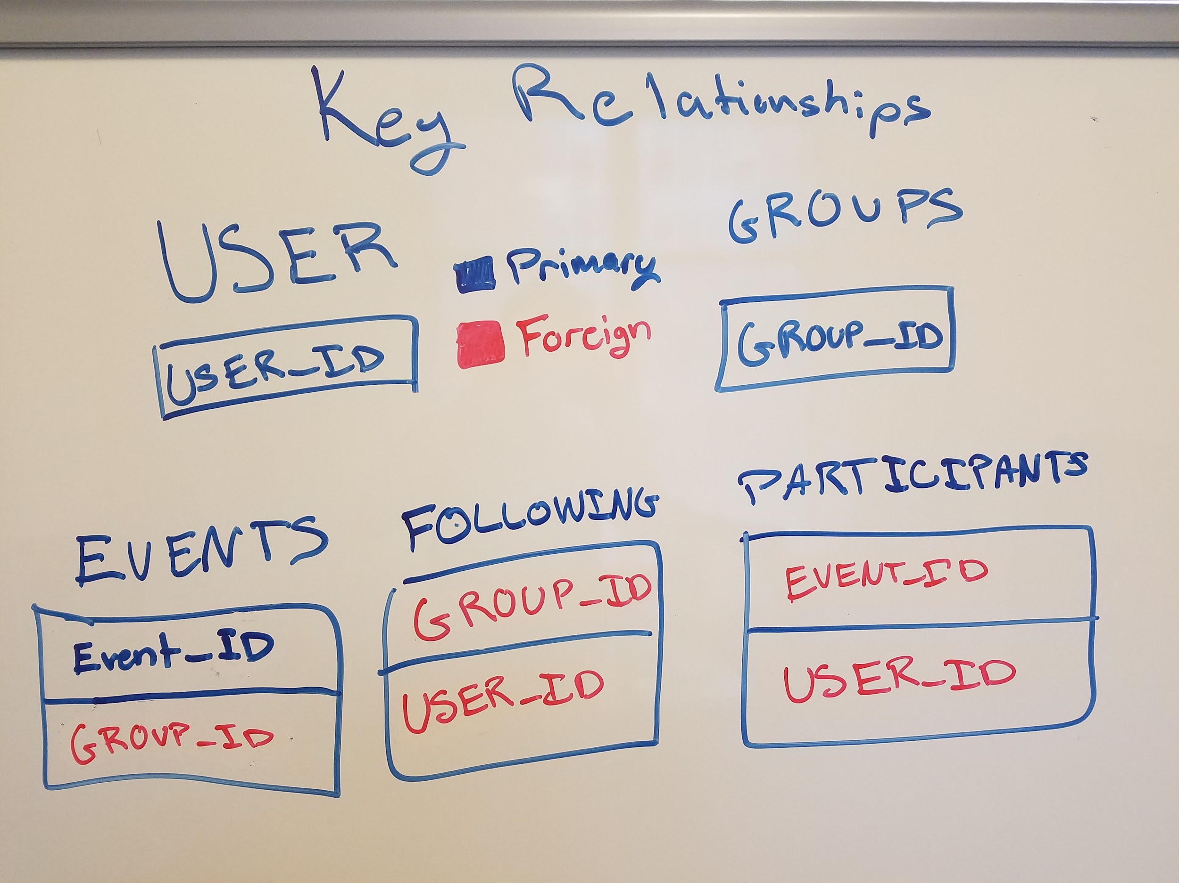
Current Progress
5 Primary table we will call from.
Gave team a quick review on SQL databases.
Successfully connected Events table

Slide 11
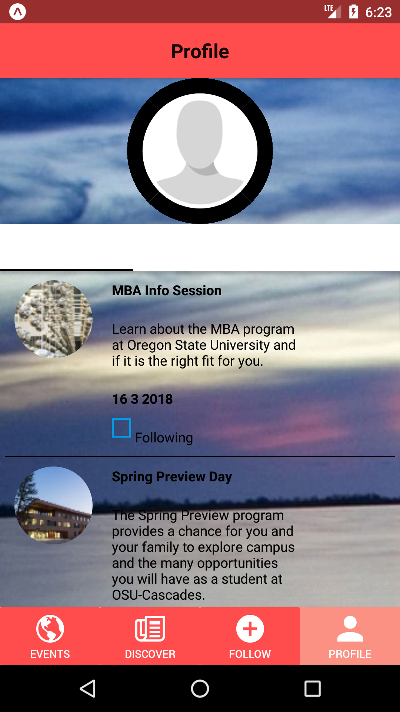
Current Progress
Profile tab displays user information
3 main tabs
My Events
Groups
Friends

Slide 12
What’s Left?
Connect rest of application to respective database
Clean up profile tab
Finish up the user interface

Slide 13
Problems and Issues
No centralized database
Grabbing “Real” data from hosts

